Slide 1
Intercast Europe: Industrial Manufacturing of CR-39®-based Solid State Nuclear Track Detectors
24th Conference on Nuclear Tracks in Solids
Bologna, September 2nd, 2008

Slide 2
NTD manufacturing Introduction
Company founded in 1965, part of PPG Industries since 2006
Worldwide leader in CR-39® -based sheet casting for Industrial and Scientific applications
The technological program for CR-39 casting for NTD applications started in 1983 in cooperation with the INFN of Bologna (Italy)
MACRO and SLIM experiments for rare particles detection in natural radiation
More than 4000m² of CR-39® sheets used as SSNTD at the end of the experiments

Slide 3
NTD manufacturing Main commercial application
Thanks to the support and partnership with the Industrial and Scientific community involved in NTD, Intercast is the leader industrial manufacturer of CR-39® sheets for SSNTD
Main commercial application is radon and neutron dosimetry
About 250,000 dosimeters sold in 2007
About 240,000 dosimeters sold in the first half 2008
Actual production capacity to support significant growth worldwide

Slide 4
NTD manufacturing Quality attributes
Main quality attributes
Background level –presence of false tracks
Transparency (post-etching)
Sensitivity
Difficult to have a general criteria to set the commercial quality
Pre-use quality acceptance test protocol is available
Quality evaluation depends on several factors as:
Pre-etching and etching parameters
Microscope Image analyzer (often custom made)

Slide 5
NTD manufacturing Key process parameters
Main quality drivers are:
Monomer and initiator
Formulation and additives
Raw material process conditions (i.e. mixing, degassing)
Polymerization thermal cycle
Environment
Internal results are considered proprietary and confidential information
Results from experiments mentioned in scientific documents showing the main drivers will be summarized

Slide 6
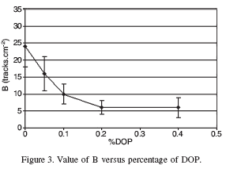
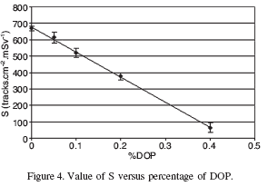
NTD manufacturing Key process parameters
DOP effect on Background and Sensitivity
Reference:
CR-39 ACCEPTANCE TEST AND OPTIMISATION FOR FAST NEUTRON DOSIMETRY APPLICATIONS
E. Fantuzzi†, B. Morelli†, G. Falangi†, L. Patrizii‡ and V. Togo‡
Radiation Protection Dosimetry, Vol. 101, Nos. 1–4, pp. 573–578 (2002)
Nuclear Technology Publishing

Slide 7
NTD manufacturing Quality assessment in 2008 production
More than 80% of SSNTDs cast in 2008 have less than 20 false-tracks cm⁻²
Gammadata Mätteknik AB acceptance test for Radon dosimetry

Slide 8
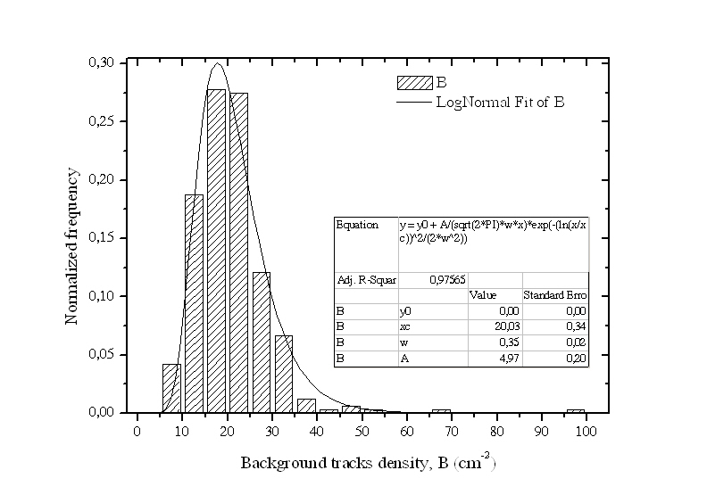
NTD manufacturing Single sheet analysis
About 78% of a large sheet has a background lower than 25 false-tracks cm⁻²
Reference:
Mariotti, F. et al., Private Communication
ENEA – Radiation Protection Institute, Via dei colli 16 – 40136 Bologna

Slide 9
NTD manufacturing Conclusions
Quality key drivers for CR-39® NTD have been identified
Technological measures have been taken designing a process to assure a reliable quality
Formulation tuning is possible to meet specific needs (i.e. Sensitivity level for fast-neutron or alfa particles dosimetry)
Quality acceptance test is available
An R&D program is still ongoing to better control and improve the quality of Intercast CR-39® sheets for NTD

