Slide 1
FT-α dating: a convenient radiometric dating method for geological glasses using natural fission-track measurement and alpha-ray spectrometry with CR-39 nuclear track detectors
Tatsuo Suzuki
Faculty of Education, Kagoshima University

Slide 2
Purpose of this study
How to measure fission-track ages without the use of reactor neutron irradiation.
→ combination with α track measurements
How to obtain them conveniently with common laboratory equipments.
→ Is it possible to calculate FT age from U
content, etched track length?

Slide 3
FT age calculation
ρｓ = λf/λ・N（e^{λT} – 1) Eq(1)
ρｓ : spontaneous fission track density (n/cm²)
λf : decay constant of spontaneous fission of U-238
λ : total decay constant of U-238
N : number of atoms of of U-238
T : age (yr)
N = Rf /2・ d ・6.022E+23/ 238.03/ I2382 ・ C Eq(2)
Rf : etched track range (Maximum track length + bulk etched depth of sample surface) (cm)
d : density of sample (g/cm³)
C : uranium content (g/g)
I238 : isotopic abundance of U-238

Slide 4
Uranium content determination
Alpha track counting from CR-39 detectors
placed on sample surface for several months to
several years to exposure for alpha particles.
Track size distribution measurements by an image
processor.
Comparison of track size distribution patterns with
pellets of powder samples standard material: IAEA
RGU1 and IAEA RGTh1 .

Slide 5
Alpha track measurements using CR-39 detectors
CR-39: BARYOTRACK (Fukubi Chemical Co.,
Japan)
Etching: 6M KOH solution at 70℃ for 90 min.
Counting: Optical Microscope with reflected light at magnification of ×1000.
Track size measurements: an image processor (Digimo Co., Japan)

Slide 6
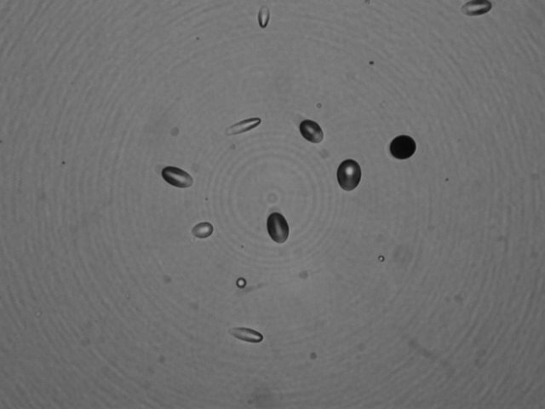
Moldavite01 Scale: 10 micrometers

Slide 7
RGU RGTh

Slide 8
1. Loading Original Photograph

Slide 9
2. Digitized

Slide 10
3. Reversing digitized Photograph

Slide 11
4. Filled empty spaces

Slide 12
4. Image analyzing

Slide 18
Size distribution patterns

Slide 20
Fitting of distribution patterns
R = (C(i)-AxU(i)-BxTh(i))²
Ax= 1/(1 + ThUx)
Bx= 1/(1 + 1/ThUx)
ThUx = Th/U (activity ratio)
Finding minimum value of R with the vorious values of the parameter of Th/U

Slide 21
Alpha track measurements
 | Duration of |  | α ｔracks |  |  | Th/U （*） | Estimeted |  | Reference
 | Exposure | No. tracks | Track density | Track density | Relative to |  | U | Th | U | Th
 | (days) | counted | (n/cm2) | (n/cm2/day) | RGU |  | (μｇ/ｇ） | (μｇ/ｇ） | (μｇ/ｇ） | (μｇ/ｇ）
RGU | 54.72 | 1748 | 8.6965E+04 | 1.5893E+03 | - | 0.46 |  |  | 400
RGTh | 54.71 | 2885 | 1.1824E+05 | 2.1610E+03 | 1.36 | 1.46 |  |  | 6.3 | 800
N610 | 95.96 | 1868 | 2.7881E+05 | 2.9055E+03 | 1.83 | 0.91 | 281.57 | 512.45 | 461.5 | 457.2
Mld01 | 836.3 | 1369 | 4.3460E+04 | 5.1966E+01 | 3.2698E-02 | 1.36 | 5.54 | 11.09

Slide 22
Etched track length measurements
Making replicas of etched surface using silicon resin.
Measurements of etch pit heights of vertical tracks (Vt) to the surface by Laser Scanning Microscope.
Measurements of etched depth (Vb) of the surface by comparison with the area covered by wax during the etching with 48% HF for glasses also by Laser Scanning Microscope (VK8500, Keyence Co., Japan)
Rf = Vt + Vb

Slide 24
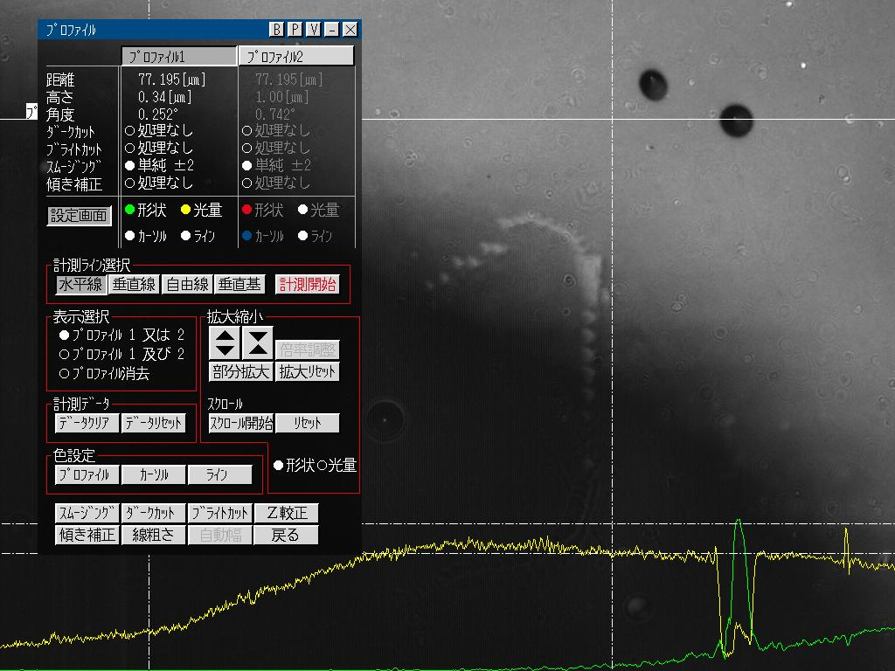

Slide 25
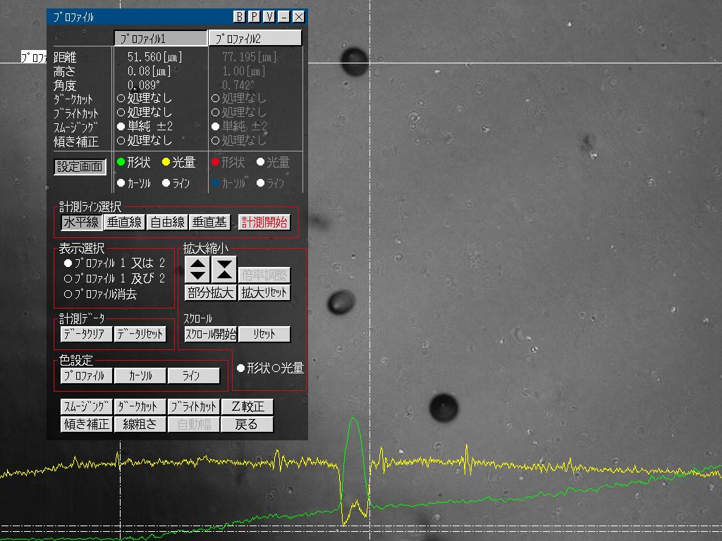

Slide 26
Fission tracks in Moldavite Spontaneous tracks Induced and Spontaneous tracks

Slide 28
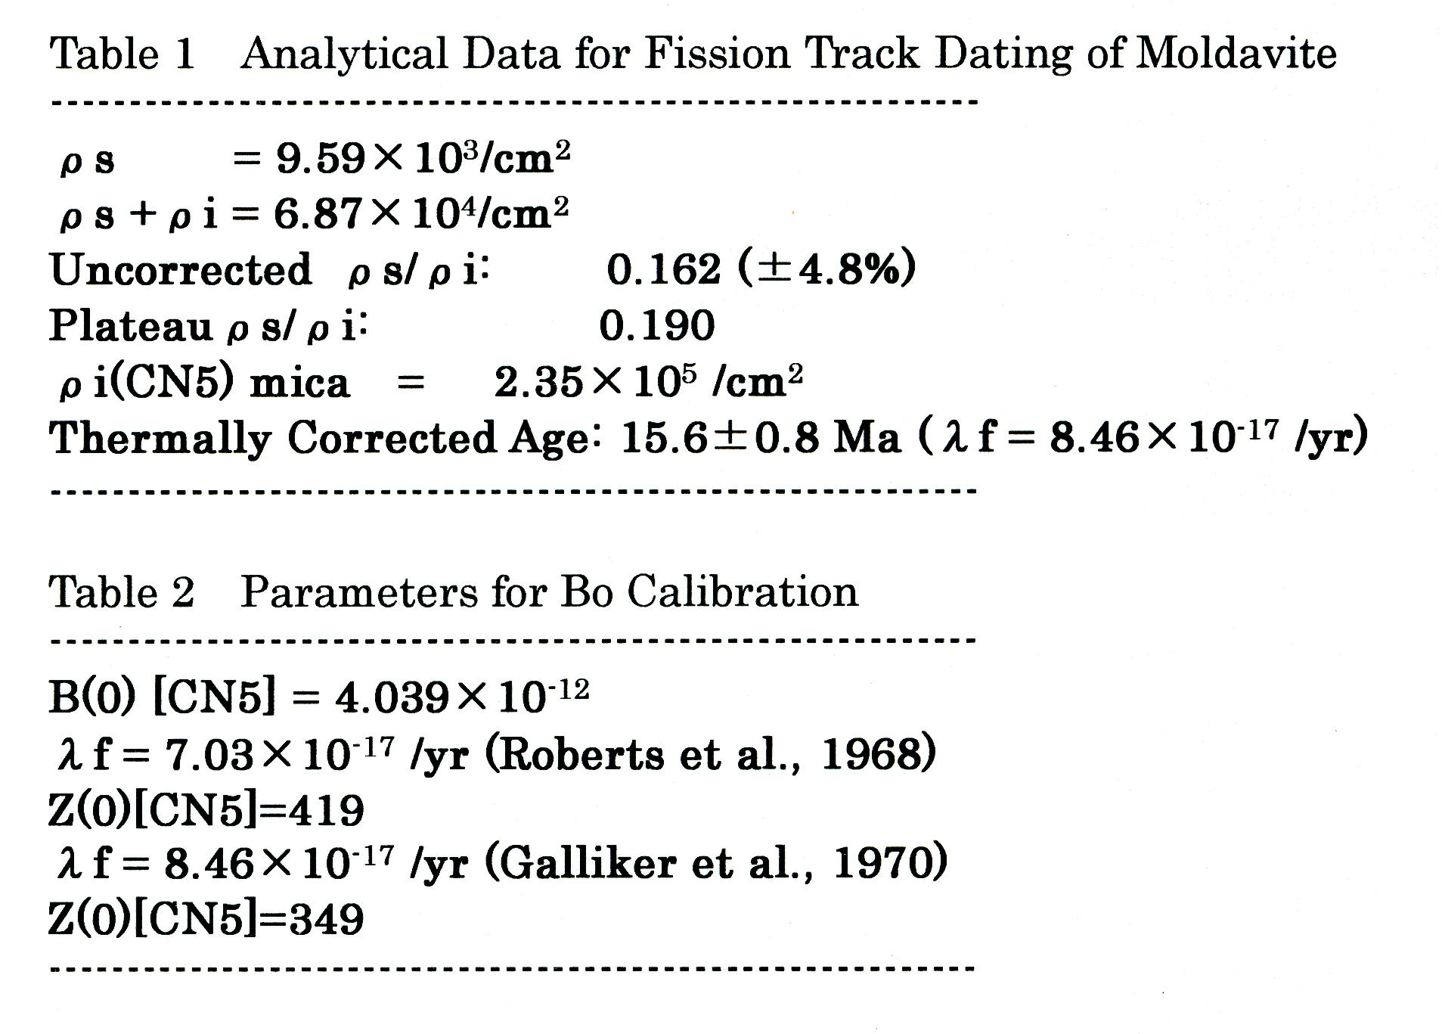

Slide 29
Calculation of FT-α age for Moldavite
U: 5.54 μg/g
Th: 11.1 μg/g
Rf = 2.61 μm
d ≈ 2 g/cm³
λｆ = 8.45 ×10⁻¹⁷/yr
T = 13.6 Ma

Slide 30
Conclusions
Conventional age determination using spontaneous fission track counting and uranium content estimation from alpha spectrometry based on track size measurements with an image processer and CR-39 nuclear track detectors was tentatively applied to determine the age of Moldavite.
Uranium and thorium content of IAEA reference samples usually used for gamma radiation measurements are also useful for alpha track measurements but it would be much better to pulverize them as much more fine state.
These experiments can be applied also to other geological glasses although it needs long exposure duration as several years for alpha particles.

Slide 31
References
Browne, E., Firestone, R.B. and Shirley, V.S (1986) Table of Radioactive Isotopes.
Wiley-Interscience
Hadler N., J.C., Iunes, P.J., Osorio A, A.M. and Paulo, S.R. (1991)
Relationship between track size and energy for alpha particles in CR-39.
Nucl. Tracks Radiat. Meas., 19, 1-4, 313-317.
Hadler N., J.C., Iunes, P.J., Paulo, S.R., Policatro, A.P. and Tello S., C.A.
(1995) A discussion on the reliability of alpha-spectroscopy using CR-39
and an image processor. Radiat. Meas., 25, 1-4, 749-752.
Hosoe, M., Takami, Y., Shiraishi, F. and Tomura, T. (1984)
Stopping power measurement using thick alpha sources. Nucl. Instr.
Methods Phys. Res., 223, 377-381.
Takami, Y., Hashimoto, T., Shiraishi, F. and Voss, K. (1986)
Quantitative analysis of alpha activities in thick sources using Si
detectors. IEEE Tracsact. Nucl. Sci. , 33, 1, 639-642.

Slide 35
Sample | Th ppm | U ppm | Ra | Th/U | Th/U act.
S-13 |  | 330
S-8 |  | 1190
S-7 |  | 4470
S-14 | 610 | 29 |  | 21.0 | 6.91
S-15 | 3630 | 85 |  | 42.7 | 14.0
S-16 | 16800 | 445 |  | 37.8 | 12.4
IAEA-312 | 91.4 | 16.5 | 2.69×10-1 | 5.54 | 1.82
IAEA-313 | 77.1 | 18.2 | 3.43×10-1 | 4.23 | 1.39
IAEA-314 | 17.8 | 56.8 | 7.32×10-1 | 0.313 | 0.103
RGU-1 | <1 | 400 | 4.83 | < 2.5×10-3 | 0.0008
RGTh-1 | 800 | 6.3 |  | 127 | 41.7
NBS SRM610 | 457.2 | 461.5 |  | 0.9907 | 0.3255

Slide 36
2.Samples
Samples used in this work are IAEA nuclear reference material of uranium ore: S-13, S-8 and S-7, Thorium ore: S-14, S-15 and S-16, Environmental Materials: IAEA-312, IAEA-313 and IAEA-314, and Gamma-ray Spectrometry Reference Materials: RGU-1 and RGTh-1. The certificated data of Ra, Th and U content by IAEA are summarized in Table.
Sample | Th ppm | U ppm | Ra | Th/U | Th/U activity
S-13 |  | 330
S-8 |  | 1190
S-7 |  | 4470
S-14 | 610 | 29 |  | 21.0 | 6.91
S-15 | 3630 | 85 |  | 42.7 | 14.0
S-16 | 16800 | 445 |  | 37.8 | 12.4
IAEA-312 | 91.4 | 16.5 | 0.269 | 5.54 | 1.82
IAEA-313 | 77.1 | 18.2 | 0.343 | 4.23 | 1.39
IAEA-314 | 17.8 | 56.8 | 0.732 | 0.313 | 0.103
RGU-1 | <1 | 400 | 4.83 | < 2.5×10-3 | 0.0008
RGTh-1 | 800 | 6.3 |  | 127 | 41.7
NBS SRM610 | 457.2 | 461.5 |  | 0.9907 | 0.3255

Slide 39
Comparison of size distribution patters
 | RGU2 | RGTh | S8 | S14 | S15 | N610 | I312 | I313 | i314 | Mold01
A(C(4)-C(7)) | 270 | 196 | 473 | 206 | 570 | 164 | 853 | 823 | 43 | 177
B(C(7)-C(13)) | 233 | 182 | 409 | 172 | 555 | 136 | 660 | 574 | 38 | 163
B/A | 0.863 | 0.929 | 0.865 | 0.835 | 0.974 | 0.829 | 0.774 | 0.697 | 0.884 | 0.921
Th/U act | 0.0008 | 12.3 |  | 6.9 | 14.033 | 0.3255 | 5.54 | 4.23 | 0.313
(Reference)
C(Size) | RGU2 | RGTh | S8 | S14 | S15 | N610 | I312 | I313 | i314 | Mold01
0 | 0 | 0 | 0 | 0 | 0 | 0 | 0 | 0 | 0 | 0
1 | 24 | 10 | 13 | 10 | 11 | 5 | 43 | 66 | 0 | 8
2 | 112 | 74 | 93 | 56 | 59 | 92 | 402 | 363 | 10 | 75
3 | 64 | 41 | 82 | 52 | 95 | 67 | 329 | 257 | 14 | 43
4 | 82 | 54 | 108 | 44 | 119 | 55 | 276 | 274 | 15 | 42
5 | 54 | 55 | 139 | 52 | 152 | 43 | 241 | 239 | 11 | 59
6 | 75 | 43 | 144 | 63 | 161 | 42 | 202 | 180 | 7 | 45
7 | 59 | 44 | 82 | 47 | 138 | 24 | 134 | 130 | 10 | 31
8 | 48 | 33 | 72 | 36 | 102 | 31 | 112 | 108 | 3 | 24
9 | 35 | 35 | 69 | 19 | 75 | 28 | 98 | 91 | 7 | 30
10 | 40 | 28 | 57 | 25 | 78 | 21 | 128 | 110 | 7 | 15
11 | 34 | 18 | 74 | 17 | 64 | 18 | 94 | 78 | 4 | 19
12 | 11 | 18 | 38 | 17 | 61 | 13 | 58 | 38 | 5 | 18
13 | 6 | 6 | 17 | 11 | 37 | 1 | 36 | 19 | 2 | 26
14 | 1 | 3 | 4 | 7 | 23 | 0 | 20 | 16 | 0 | 20
15 | 0 | 6 | 5 | 1 | 9 | 0 | 13 | 6 | 1 | 21
16 | 0 | 3 | 2 | 0 | 3 | 1 | 10 | 5 | 1 | 7
17 | 1 | 1 | 1 | 0 | 2 | 0 | 5 | 5 | 2 | 2
18 | 2 | 1 | 0 | 0 | 2 | 0 | 3 | 4 | 0 | 2
19 | 1 | 0 | 2 | 0 | 2 | 0 | 2 | 5 | 0 | 0
20 | 0 | 0 | 2 | 0 | 1 | 0 | 0 | 5 | 1 | 2
 | RGU2 | RGTh | S8 | S14 | S15 | N610 | I312 | I313 | i314 | Mold01
A(C(4)-C(7)) | 270 | 196 | 473 | 206 | 570 | 164 | 853 | 823 | 43 | 177
B(C(7)-C(13)) | 233 | 182 | 409 | 172 | 555 | 136 | 660 | 574 | 38 | 163
B/A | 0.863 | 0.929 | 0.865 | 0.835 | 0.974 | 0.829 | 0.774 | 0.697 | 0.884 | 0.921
Th/U act | 0.0008 | 12.3 |  | 6.9 | 14.033 | 0.3255 | 5.54 | 4.23 | 0.313
(Reference)
C(Size) | RGU2 | RGTh | S8 | S14 | S15 | N610 | I312 | I313 | i314 | Mold01
0 | 0 | 0 | 0 | 0 | 0 | 0 | 0 | 0 | 0 | 0
1 | 24 | 10 | 13 | 10 | 11 | 5 | 43 | 66 | 0 | 8
2 | 112 | 74 | 93 | 56 | 59 | 92 | 402 | 363 | 10 | 75
3 | 64 | 41 | 82 | 52 | 95 | 67 | 329 | 257 | 14 | 43
4 | 82 | 54 | 108 | 44 | 119 | 55 | 276 | 274 | 15 | 42
5 | 54 | 55 | 139 | 52 | 152 | 43 | 241 | 239 | 11 | 59
6 | 75 | 43 | 144 | 63 | 161 | 42 | 202 | 180 | 7 | 45
7 | 59 | 44 | 82 | 47 | 138 | 24 | 134 | 130 | 10 | 31
8 | 48 | 33 | 72 | 36 | 102 | 31 | 112 | 108 | 3 | 24
9 | 35 | 35 | 69 | 19 | 75 | 28 | 98 | 91 | 7 | 30
10 | 40 | 28 | 57 | 25 | 78 | 21 | 128 | 110 | 7 | 15
11 | 34 | 18 | 74 | 17 | 64 | 18 | 94 | 78 | 4 | 19
12 | 11 | 18 | 38 | 17 | 61 | 13 | 58 | 38 | 5 | 18
13 | 6 | 6 | 17 | 11 | 37 | 1 | 36 | 19 | 2 | 26
14 | 1 | 3 | 4 | 7 | 23 | 0 | 20 | 16 | 0 | 20
15 | 0 | 6 | 5 | 1 | 9 | 0 | 13 | 6 | 1 | 21
16 | 0 | 3 | 2 | 0 | 3 | 1 | 10 | 5 | 1 | 7
17 | 1 | 1 | 1 | 0 | 2 | 0 | 5 | 5 | 2 | 2
18 | 2 | 1 | 0 | 0 | 2 | 0 | 3 | 4 | 0 | 2
19 | 1 | 0 | 2 | 0 | 2 | 0 | 2 | 5 | 0 | 0
20 | 0 | 0 | 2 | 0 | 1 | 0 | 0 | 5 | 1 | 2

Slide 41
S8 S14

Slide 42
IAEA314 Scale: 10 micrometers

Slide 43
IAEA312 IAEA 313

