Slide 1
Atomic Force Microscopy Analysis Methods for short-range, high-LET recoil tracks in CR-39 PNTD
C. E. Johnson¹, E. R. Benton¹, N. Yasuda², and E. V. Benton³
¹Dept. of Physics, Oklahoma State University, Stillwater, OK 74078 USA
²National Institute of Radiological Sciences, Chiba, Japan
³Dept. of Physics, University of San Francisco, San Francisco, CA 94117 USA
24th ICNTS 1-5 September 2008

Slide 2
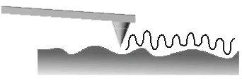
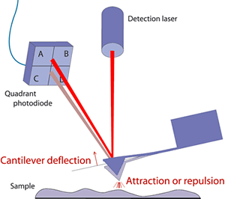
Atomic Force Microscope Analysis of CR-39
Optical microscopy requires a minimum bulk etch ≈8 µm
Particles with range shorter than the bulk etch are removed
Reduced etching leaves the tracks of short-ranged particles
The AFM accurately measures sub-micron features
AFM allows fluence in excess of 10⁸ cm⁻² (~10⁵ cm⁻² for optical microscopy)

Slide 3
AFM image of exposed CR-39
False-color mapping assigns dark color to deep areas and light color to higher areas
Etch is 6.25 N NaOH at 50° C for 2 hours
Bulk etch (B) is 0.5 µm
AFM used is a Veeco Dimension 3100 with NanoScope® IIIa controller
10 µm x 10 µm

Slide 4
Image analysis methods
The AFM auto scan captures 100 images sequentially
Each scan takes ~ ½ hr
The scans are saved to disk with a sequential suffix
Post-scan processing: flattening and plane fitting
Then the tracks can be measured

Slide 5
Topographic analysis
10 µm x 10 µm
10 µm x 10 µm
AFM data is a 3-D matrix, not an image
Instead of image analysis use topographic tools for analysis
Contours are assigned to regularly spaced isoclines
Steep areas have closely spaced isoclines

Slide 6
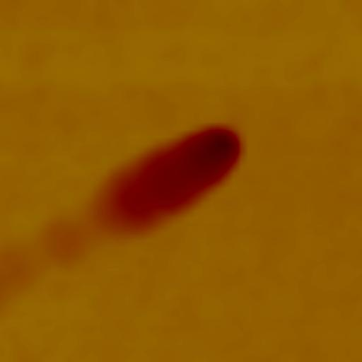
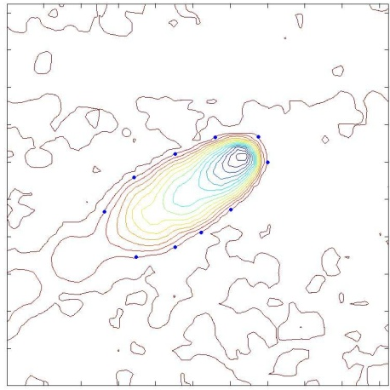
Track analysis overview
AFM Scan
Topographic Map
Ellipse Fitting

Slide 7
Example track details

Slide 8
Automation of Analysis
Capture the entire isocline (x_{i},y_{i}) matrix for each ellipse
The fit is applied to all i points (typically i is >100)
Check the fit (EOF)
Reject the fit if poor
Faster than manual analysis

Slide 9
3-D track reconstruction
Analyze multiple isoclines to extract geometric features of interest
More information than just V_{R}
The center of the ellipse gets a blue cross
The red line connects the centers from the bottom up
Could be used to identify fragmentation events
Find tracks with rapidly changing LET

Slide 10
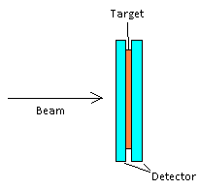

Slide 11
Conclusions
AFM Data is 3-D so we can use topographic tools to replace image processing methods
The topographic/least squares ellipse fitting method surpasses our previous methods by increasing accuracy and reducing analysis time
Analysis of short-range, high-LET particles is facilitated using a short etch (500 nm) and AFM scanning of the detector

Slide 12
Future work
Optimization of our analysis methods for various AFM scan parameters
Work continues on 3-D track reconstruction methods
We plan to incorporate this code into a full analysis package (GUI)
Analyze results obtained with varied bulk etch

Slide 13
Acknowledgements
LLUMC- AFM donation and beam time for proton exposures
BNL- NASA Space Radiation Laboratory (NSRL)

Slide 14
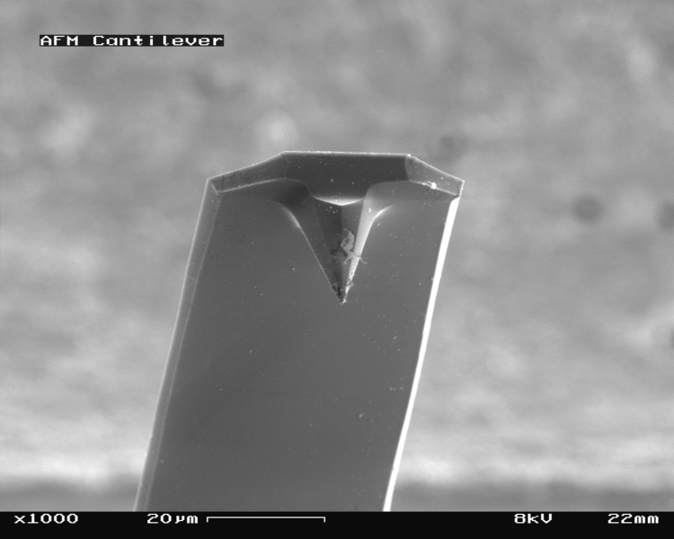
Extra slides: AFM Background
Invented in 1986 by Binnig, Quate and Gerber (Gerd Binnig was co-inventor of the STM)
First applied to scanning tracks in Mica in 1993 by Price et al to study track etch behavior
Advances in Bulk Etch determination were made by Yasuda et al in 1998
SEM image of an AFM tip ()

Slide 15
Extra slides: Veeco Dimension 3100 AFM with NanoScope® IIIa Controller

Slide 16
Extra slides: Nanoscope section analysis

Slide 17
Extra slides: Least Squares Ellipse Fitting and EOF
Requires at least 5 points
The more the better
The contour should be well sampled with evenly spaced points
For manual analysis we select at least 10 edge points
If the EOF is poor the fit is rejected and retried with fewer points
Agin, 1981

Slide 18
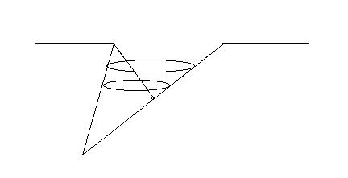
Extra slides: AFM image artifacts
Due to the shape of the tip, the AFM can record erroneous shapes under certain conditions
If the track is undercut for example the tip does not see the true bottom of the track
This must be accounted for in the contour analysis by rejecting portions of the recorded edge and fitting to the portion known to be good
With proper algorithms it is possible to reconstruct the actual geometry from the AFM image
Edge artifact
Proper contour fit
reconstructs track

Slide 19
Extra slides: Detector response function

Slide 20
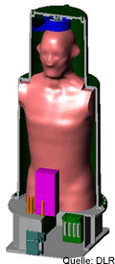
Extra slides: Differential fluence

Slide 21
Least squares ellipse fitting
Points are selected manually on the top-most complete contour

Slide 22
Least squares ellipse fitting

