Slide 1
Search for Strange Quark Matter and Q-Balls with the SLIM Experiment.
Zouleikha Sahnoun
Astrophys. Dept. CRAAG, Algiers & INFN Bologna, Italy

Slide 2
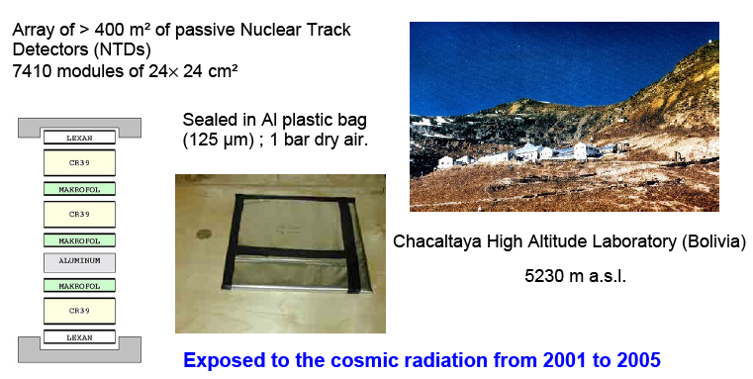
The SLIM experiment
Search for LIght Magnetic monopoles

Slide 3
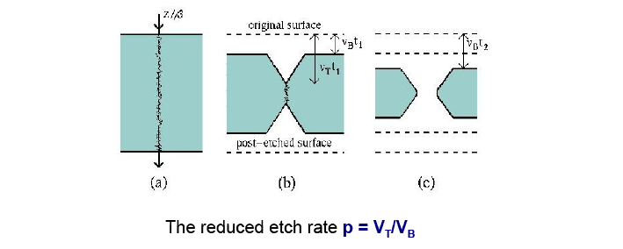
The SLIM experiment
Search for LIght Magnetic monopoles
μ
Nuclear
fragment
Fast
MM
Slow
MM
CR39
LEXAN
Al
1 mm
Dependent on the deposited energy : Restricted Energy Loss (REL)
Calibration →
curves p versus REL

Slide 4
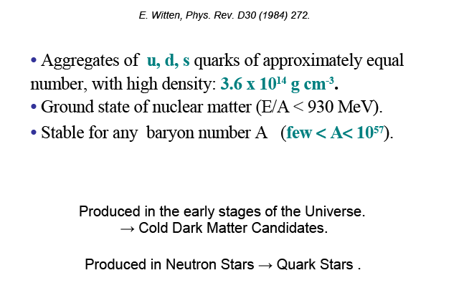
Strange Quark Matter alias SQM, Nuclearites, Strangelets, Quark Bags

Slide 5
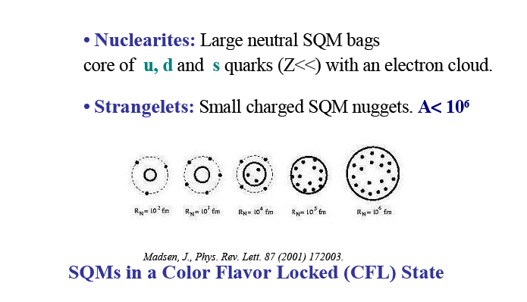
Strange Quark Matter alias SQM, Nuclearites, Strangelets, Quark Bags

Slide 6
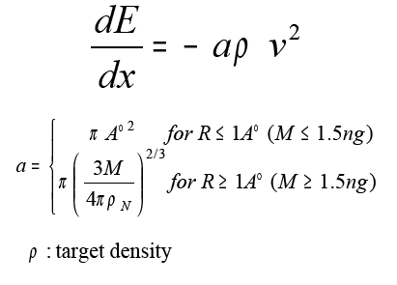
Nuclearites Energy Loss
Elastic and quasi-elastic collisions with atoms and molecules

Slide 7
SLIM could record any
nuclearite with mass
above 3 10¹⁰ GeV/c²
The Minimum velocity versus mass for Nuclearites at the top of the atmosphere to be detected by the SLIM experiment.

Slide 8
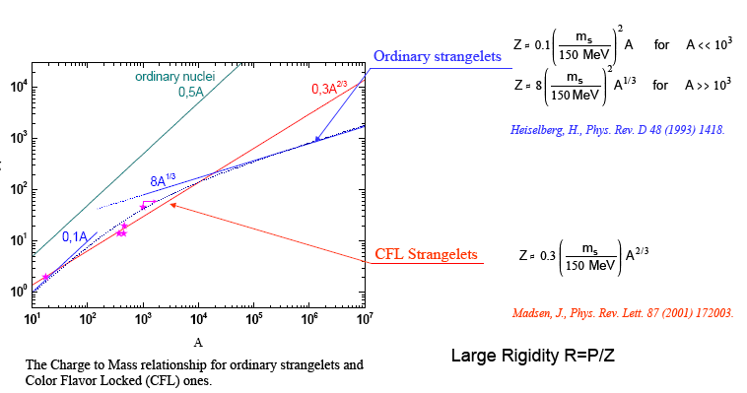
Strangelets
  Characteristic signature:
  A very low charge to mass (Z/A) ratio!

Slide 9
Strangelets
  Behave like ordinary nuclei
  Same acceleration processes and Energy Loss !
Restricted energy loss of strangelets in CR39 Nuclear track detectors

Slide 10
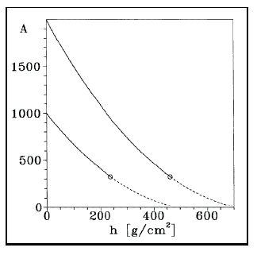
Strangelets Propagation
in Atmosphere
Two kinds of phenomenological models:
Strangelets losing mass when colliding with air nuclei:
- Wilk,G. et al. J. Phys. G 22 (1996) L105.
Small strangelets accreting neutrons and protons
increasing their mass and charge.
- Banerjee S., et al., J. Phys. G 25 (1999) L15.

Slide 11
Strangelets Propagation
in Atmosphere
Two kinds of phenomenological models:
Strangelets losing mass when colliding with air nuclei:
- Wilk,G. et al. J. Phys. G 22 (1996) L105.
Minimum Baryon number to reach
Chacaltaya Laboratory A_{initial}> 2200.

Slide 12
For Z_{initial} = 2 above atmosphere
➔ Z at Chacaltaya about 14
Small strangelets accreting neutrons and protons
increasing their mass and charge.
- Banerjee S., et al., J. Phys. G 25 (1999) L15.

Slide 13
Predictions
J. Madsen, Phys. Rev. D71 (2005) 014026
Two fluxes proposed:
→ Strange star binary collision + propagation in the galaxy: F ∝ A^{-0.467} Z^{-1.2} max[R_{SM}, R_{GC}]^{-1.2}.
→ Candidate events + relative abundance of elements in the Universe: F ∝ A^{-7.5}.
Rybczynski M. et al. Nucl. Phys. B (Proc. Suppl.) 151 (2006) 341
Chacaltaya Laboratory 540 g/cm² (1sr):
Madsen: ~ 300 events/100 m² / year.
Wilk*: ~ 6 events/100 m² / year.
Banerjee*: ~5-10 events/100 m² / year.

Slide 14
Experimental Results
The analysis of 427 m² of NTDS exposed for 4.22 years showed NO EVENT
Nuclearites
Flux Upper Limits at 90% C.L.
for downgoing Strange Quark Matter
1.3 10⁻¹⁵ cm⁻² s⁻¹ sr⁻¹

Slide 15
Experimental Results
The analysis of 427 m² of NTDS exposed for 4.22 years showed NO EVENT
Strangelets
Flux Upper Limits at 90% C.L.
for downgoing Strange Quark Matter
1.3 10⁻¹⁵ cm⁻² s⁻¹ sr⁻¹
^{Propagation Models ?}
Banerjee et al. May be excluded.
Wilk et al. Only marginaly excluded.

Slide 16
Q-Balls
Hypothetical coherent states of squarks, sleptons and Higgs fields.
→ Dark Matter candidate.
Neutral Q-balls (SENS) main interaction process is the catalysis of proton decay. Not relevant for NTDs.
- Charged Q-balls (SECS) are similar to nuclearites and strangelets and behave like ordinary nuclei: same interaction processes !

Slide 17
Flux Upper Limit of Charged Q-Balls

Slide 18
Conclusion
The SLIM experiment was able to detect Strange Quark Matter charged Q-balls .
The null observation sets a flux upper limit at the 90% C.L. of 1.3 10⁻¹⁵ cm⁻² s⁻¹ sr⁻¹
Models of strangelets propagation through the Earth atmosphere were constrained.

Slide 19
Thank You.

